Slide 1
Text Mining with Python
Sridhar Palle, Ph.D.

Slide 2
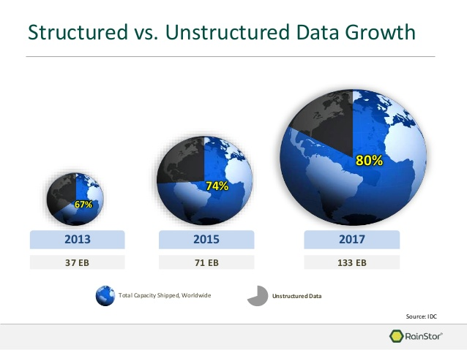
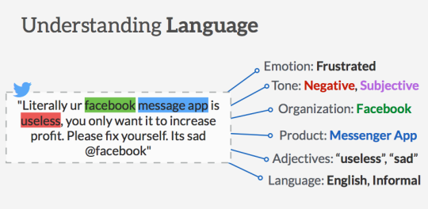
Why Text Mining?
Majority of worlds data is in unstructured form (most of which is text) (Merrill Lynch and Gartner study)
Unstructured corporate data is doubling in
size every 18 months. Ex: 500 million tweets/day
If all the data in the world was equivalent to water on earth, then textual data is like the ocean, making up a majority of the volume (Siegel 2013)
So what exactly is text mining
A process of analyzing vast collections of textual documents to extract key concepts, themes, hidden trends, and make predictions
Better fits the “mining” metaphor in data mining. Separate valuable key words from a mass of other words.
Generating actionable intelligence from textual data is of paramount importance for a variety of industries and applications (Ex: Facebook)
Source: blog.aliyen.com
Notes:
A vast majority of business data are stored in text documents that are virtually unstructured. According to a study by Merrill Lynch and Gartner, 85 to 90 percent of all corporate data are captured and stored in some sort of unstructured form (McKnight, 2005).The same study also stated that this unstructured data are doubling in size every
18 months. Because knowledge is power in today’s business world, and knowledge is derived from data and information, businesses that effectively and efficiently tap into their
text data sources will have the necessary knowledge to make better decisions, leading to a competitive advantage over those businesses that lag behind.

Slide 3
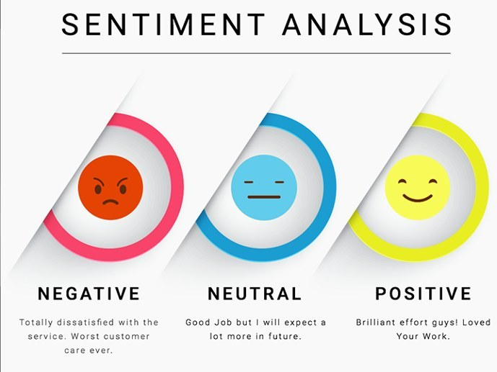
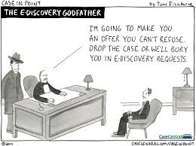
Text Mining Applications
Sentiment Analysis
Ex: analyzing tweets for brand sentiment
Spam filtering, event detection in emails
Ediscovery problem in Litigation
Marketing applications
Enables better CRM
Security applications
Deception detection
Medicine and biology
Analyzing clinical reports
Academic applications
Journal reviews
Research stream analysis
Source: kdnuggets

Slide 4
Text Mining Process
1. Collect Data
Raw Unstructured data from websites, emails, tweets, journals
2. Preprocess Data
3. Analyze Data
Convert to a structured format
Apply standard descriptive or predictive analytics techniques such as clustering, classification etc.

Slide 5
Text Mining Process
Step 1: Collect Data
Index | Document (tweet, email, article, webpage etc)
1 | I promise that I didn't just sign up to Amazon Prime Video just so I didn't have to get out of bed to put on a different DVD I would never do such a thing
2 | Watch out, online retailers. This is just how big Amazon is becoming:
3 | Amazon Prime Day will last 36 hours this year. As if they haven’t already disrupted enough industries they are now going after time.
4 | ……
5 | …….
6 | I’m a hypocrite who uses @amazon but reading about exploiting people beyond their breaking point & destroying local economies so @JeffBezos can become wealthiest person on planet has me re-thinking it

Slide 6
Text Mining Process
Step 2 : Preprocess – clean & convert to structured format
Step 3 : Applying clustering or predictive analytics
Ex: Bag of Words Method (baseline NLP method): One feature for each word
Clean up and break down text into structured format
1. Tokenize: Break down each document or tweet into words
2. Transform Cases: convert to lower or capital case
3. Remove stop words: ‘a’, ‘or’, ‘is’, ‘are’
4. Remove Punctuation: @, . “, /
5. Stemming
6. n-grams
Twt | Amazon | big | never | hypocrite | sign | ..
Tw.1 | 1 | 1 | 0 | 0 | 1 | 1
Tw.2 | 2 | 1 | 0 | 1 | 0 | 2
Tw.3 | 1 | 0 | 1 | 0 | 0 | 1
Tw.4 | 1 | 2 | 0 | 1 | 0 | 0
Tw.5 | 1 | 0 | 1 | 2 | 1 | 1
Tw.6 | 3 | 1 | 0 | 0 | 1 | 0

Slide 7
Text Mining with Python
Please go to the link below
Tinyurl.com/ece-bdata-python/
Download the folder
TM
Open Jupyter notebooks related to text mining using Anaconda

